Slide 1

Introduction to Operating Systems CS/COE 1550
Summer 2020-2021
Sherif Khattab
ksm73@pitt.edu
(Some slides are from Silberschatz, Galvin and Gagne ©2013)

Slide 2
Announcements
Upcoming deadlines:
Lab 1 and Homework 2: due on 6/4
Project 1: due on 6/14
Typo in Lab 1 and Project 1 README files.
Please change 2214 to 2217 in the GitHub URL.
Office hours
Piazza

Slide 3
Last Lecture …
Semaphore
Usage Problems
Implementation
Monitors
Usage
Condition Variables

Slide 4
Muddiest Points (1/3)
Priority Inheritance
In the example you showed in class, which process is adopting the priority of the other process, and what is the justification for this?
with every nested interrupt that down()s the same semaphore, that process will automatically inherit the highest priority out of all the processes that requested the same semaphore? Then with all priorities being equal, execution starts in order of initial request?
If semaphores use spinlocks anyway, how are they more efficient than spinlocks? I suspect it's because they are not doing much while spinlocking, but want to make sure.
monitors and semaphores
When is it appropriate to use a monitor vs a semaphore, or are they used in conjunction?
Just an example of how monitors work/are used, maybe with some pseudocode
When we use a semaphore or mutex in the real world for controlling a critical section is that construct provided by the kernel like our Project 1 or is that constructed in user land using atomics?
How to deal with compiler code reordering with memory barriers?
Also, how to keep track of waiting processes for each semaphore in the semaphore list?
How does a mutex keep track of the process that called down on it? Would it store the PID or the address of the PCB?
how to start project 1
project 1 objectives

Slide 5
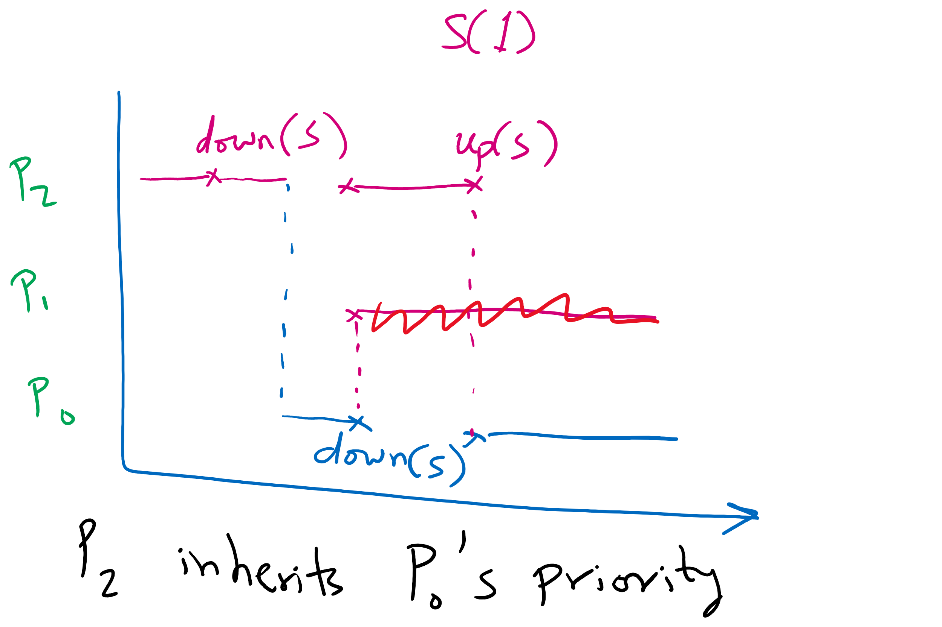
Priority Inheritance Example

Slide 6
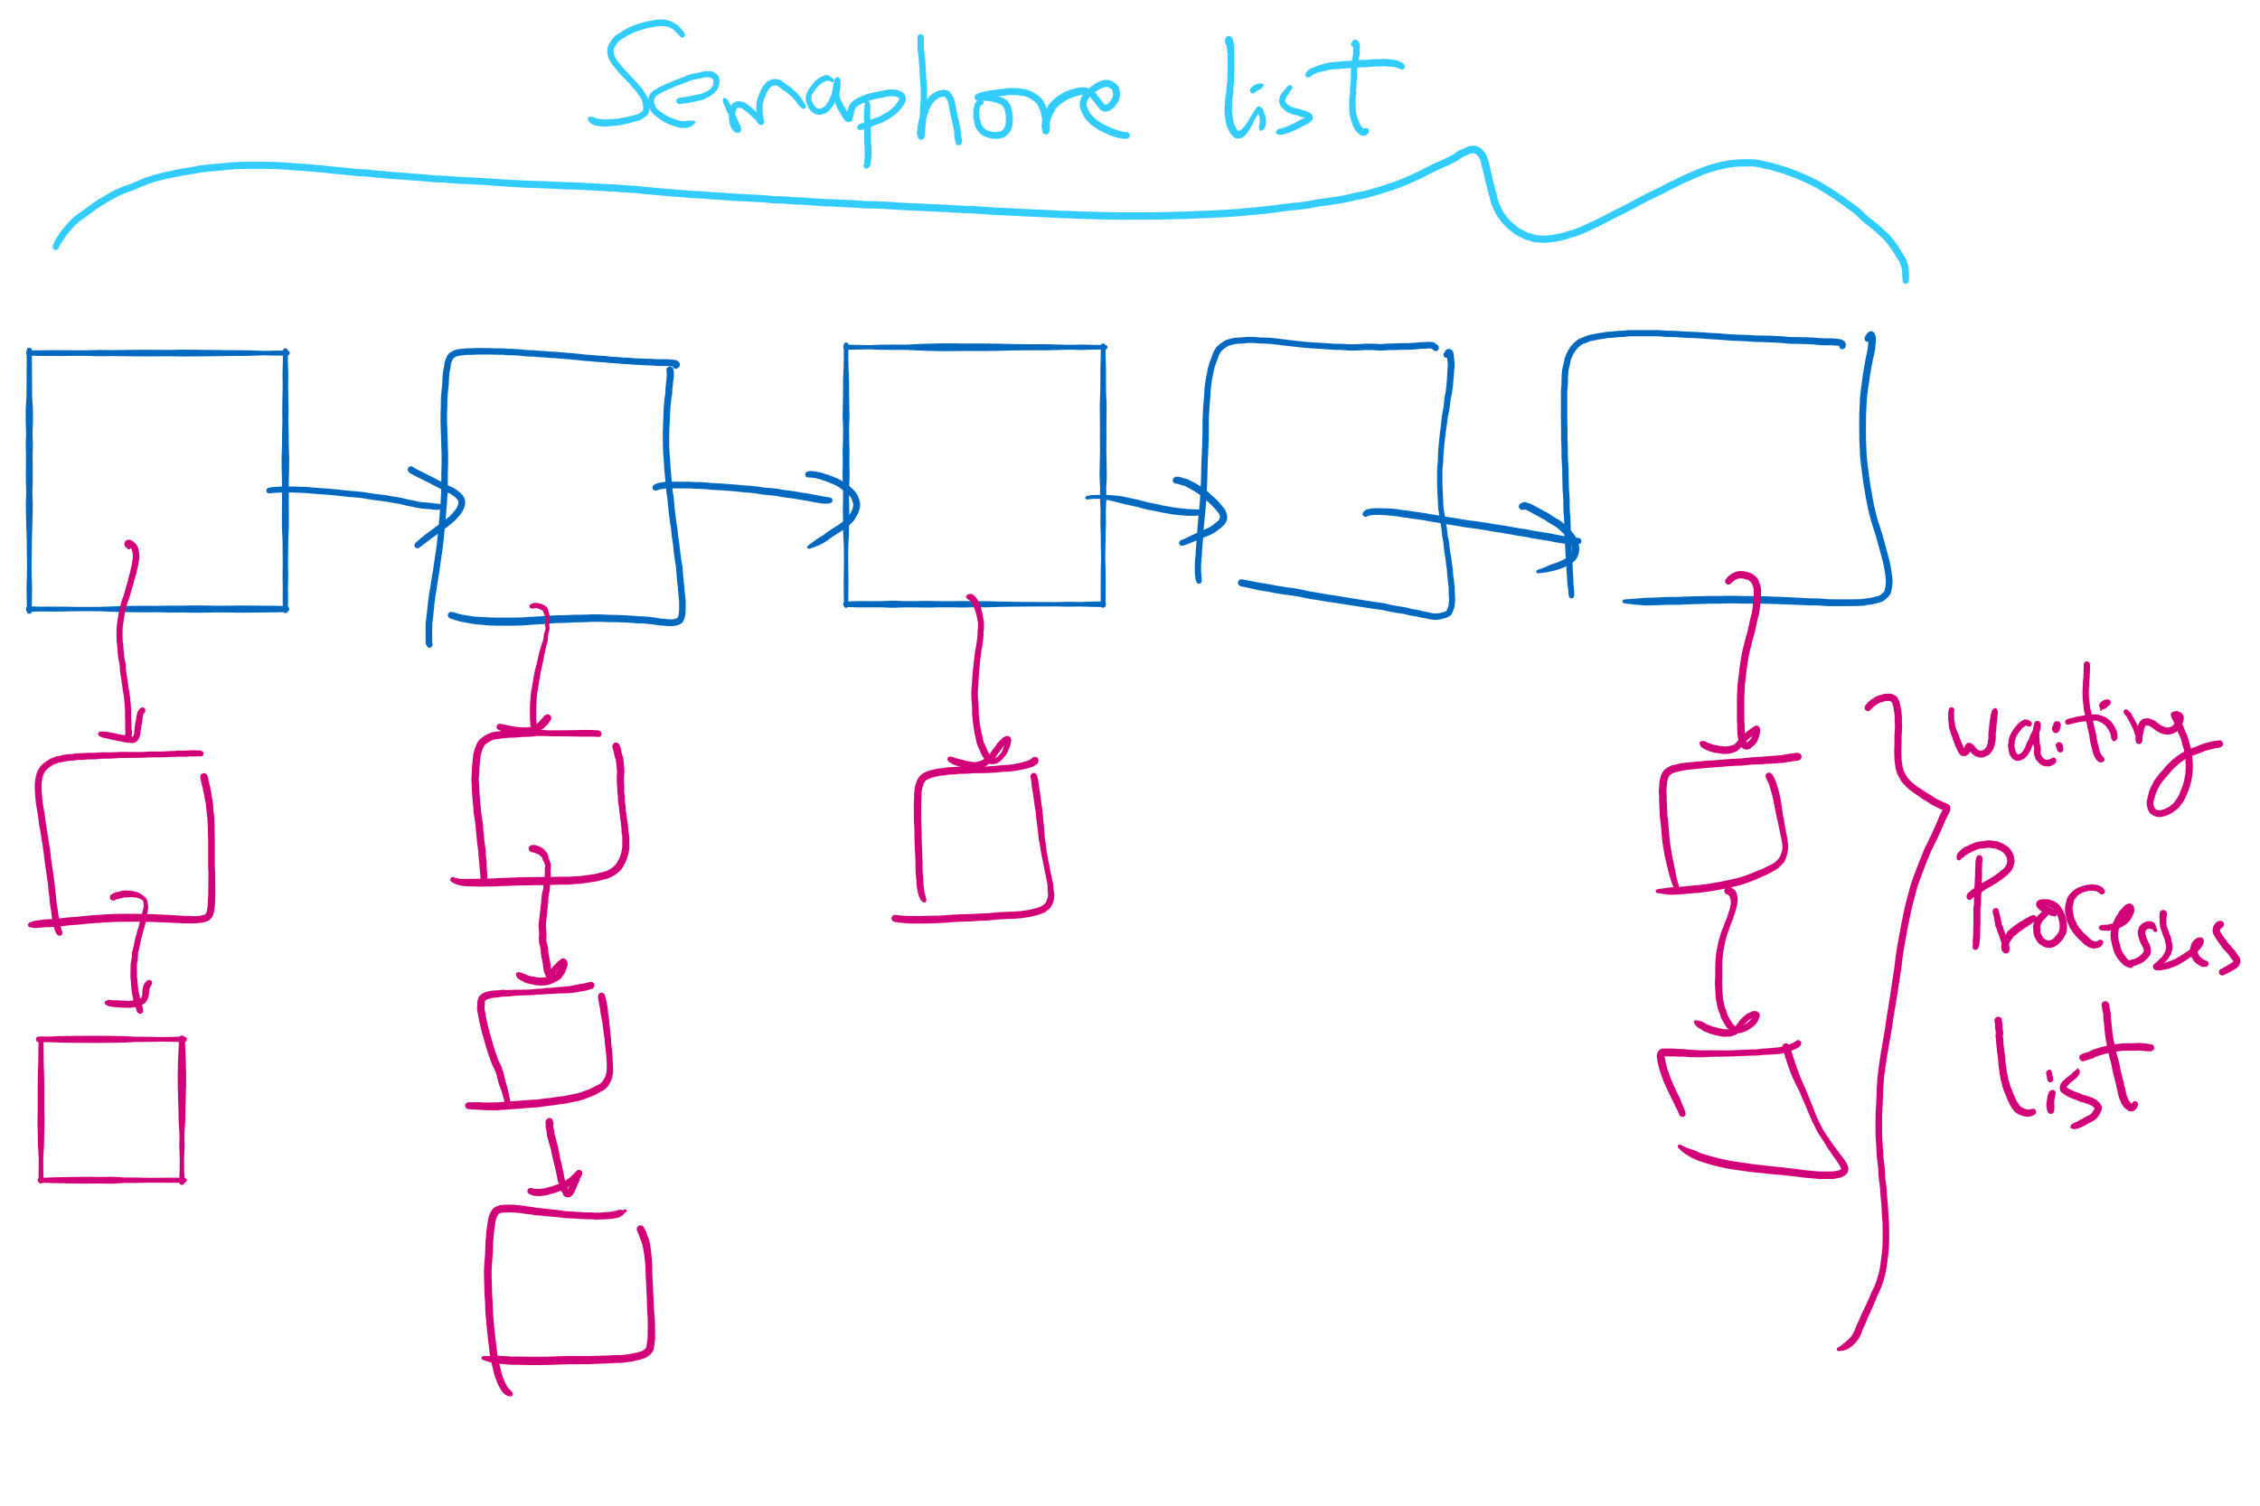
Linked Lists in Project 1

Slide 7
Muddiest Points (2/3)
Semaphores
the problems with using semaphores
Implementation
How is a semaphore using a spin lock better than a spinlock
Semaphores, all of it lol, but I'm planning on reading the textbook too.
preventing errors with down() and up()
counting semaphores (How do the other values in counting semaphores work)
Semaphore starvation
semaphores in code
Semaphore vs. Spinlock
recognizing when you'd use a semaphore vs a spinlock
What is the difference between a spinlock and a semaphore that uses busy waiting? They both seem to do the same thing
Priority Inversion
Priority inversion in semaphores and what practical effects it can have on your system? Maybe an example
A little hazy on how priority queue effects semaphores and spinlocks
How priority inheritance works with processes and semaphores

Slide 8
Muddiest Points (3/3)
What exactly monitors are
The implementation of the stuff talked about today
Please explain more about cs1550.c file in project
How does a mutex know if it’s being down()d by different process that didn’t up()d it?
Maybe a little more on the events leading up to starvation.
How a critical section can be re-ordered
according to the slides, there is no max limitation for the wakeup linked list, is this always the case? and if spinlock better under few processes, any ways to use spinlock under fewer processes in parellel with semaphores under larger processes
Busy wait

Slide 9
Today’s Agenda …
Monitors
Condition Variables and (Sleep)Locks
Monitor Implementation
Other synchronization mechanisms

Slide 10
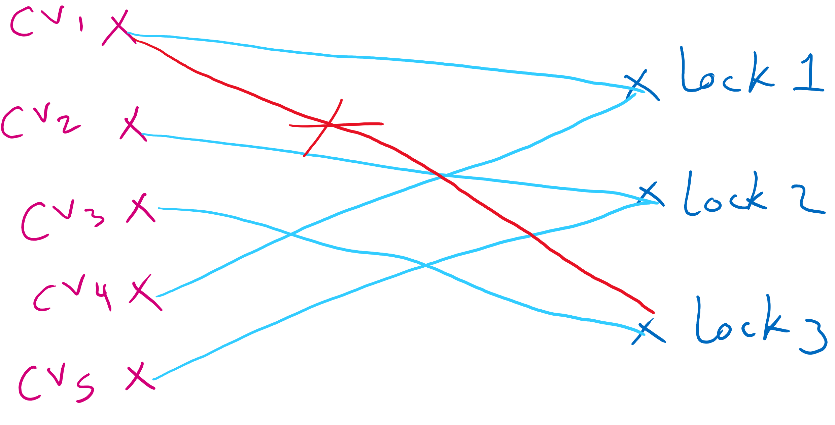
Locks & condition variables
Monitors require native language support
What if native support is not there (e.g., in C)?
Provide monitor support using special data types and procedures
Locks (Acquire(), Release())
Condition variables (Wait(), Signal())
Lock usage
Acquiring a lock == entering a monitor
Releasing a lock == leaving a monitor
Condition variable usage
Each condition variable is associated with exactly one lock
Lock must be held to use condition variable
Waiting on a condition variable releases the lock implicitly and reacquires the lock upon returning

Slide 11
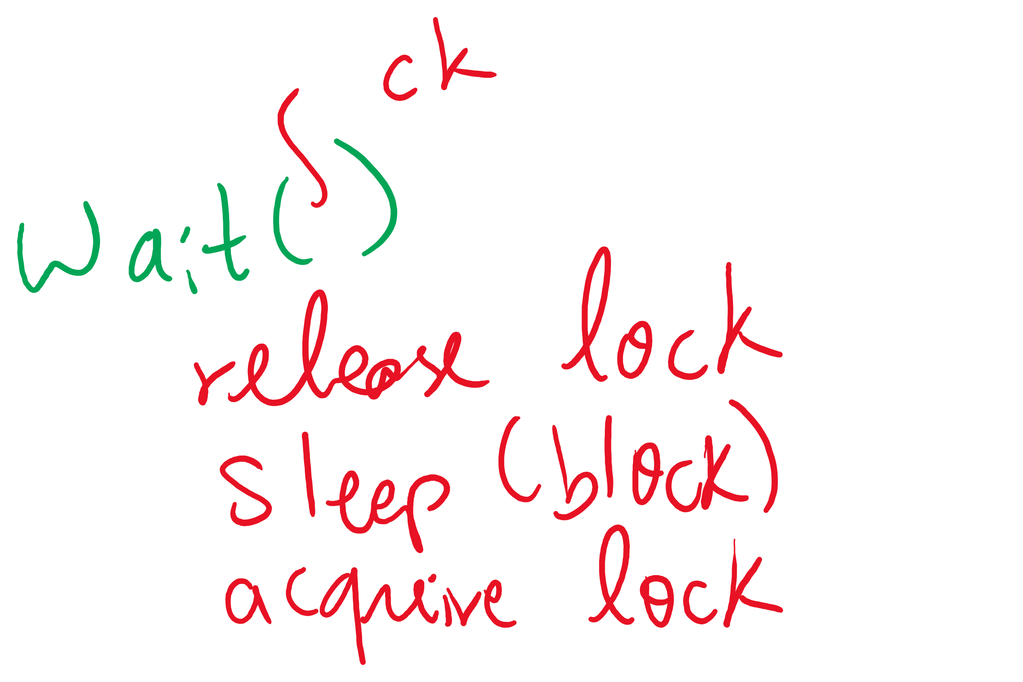


The three steps of the wait() operation

Slide 12
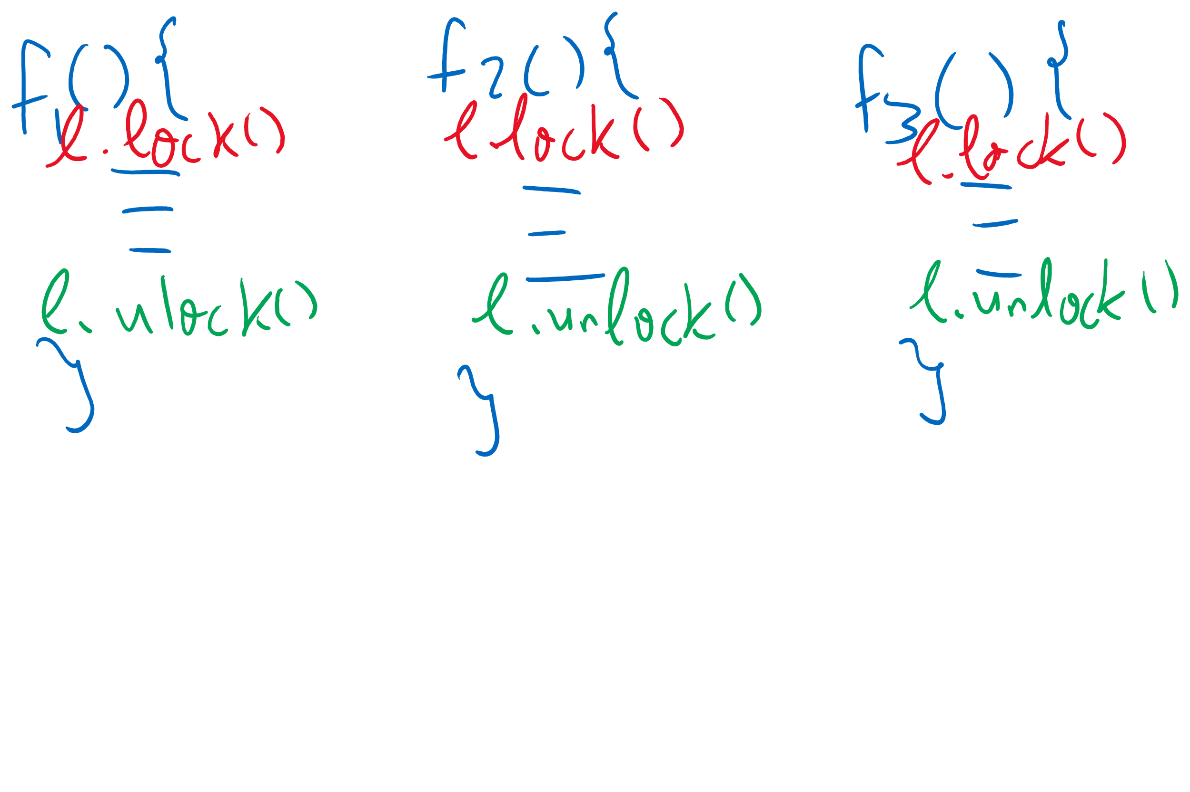
Adding Monitors in C

Slide 13
Monitor semantics
Question: which process gets the monitor after Signal()?
Problem: P signals on condition variable X, waking Q
Both can’t be active in the monitor at the same time
Which one continues first?
Mesa semantics
Signaling process (P) continues first
Q resumes when P leaves the monitor
Seems more logical: why suspend P when it signals?
Hoare semantics
Awakened process (Q) continues first
P resumes when Q leaves the monitor
May be better: condition that Q wanted may no longer hold when P leaves the monitor

Slide 14
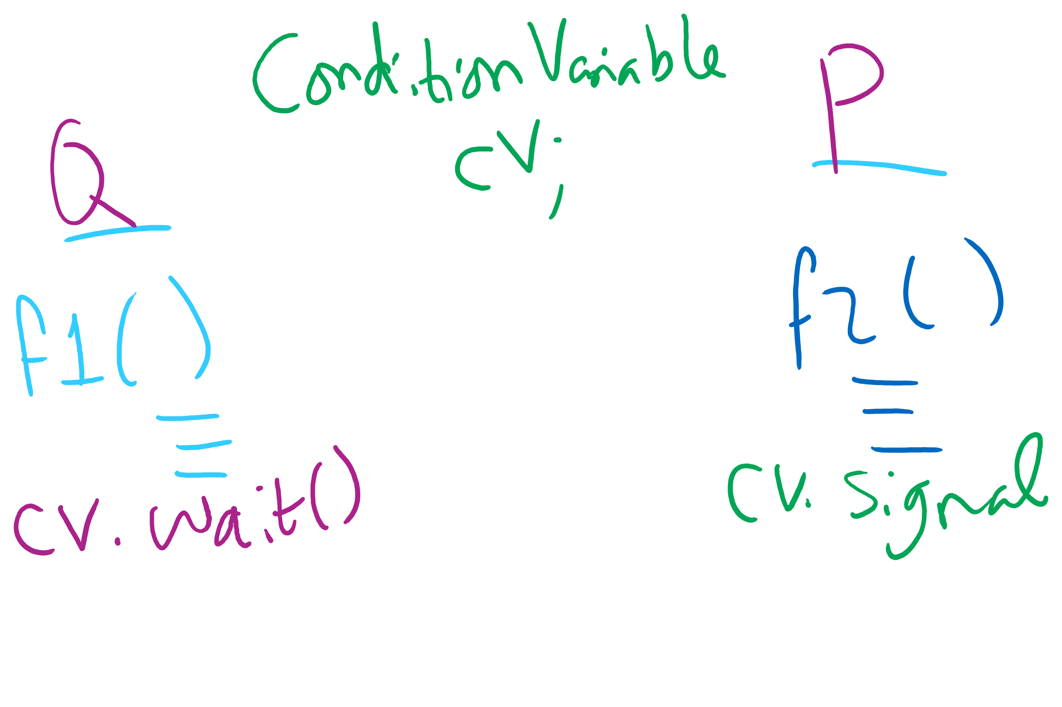
Signaling and Signaled Processes

Slide 15
Condition Variables wait()
Use a while loop around the wait()
While(some condition)
condvar.wait();
Why??
Think Mesa semantics!
Spurious wakeups

Slide 16
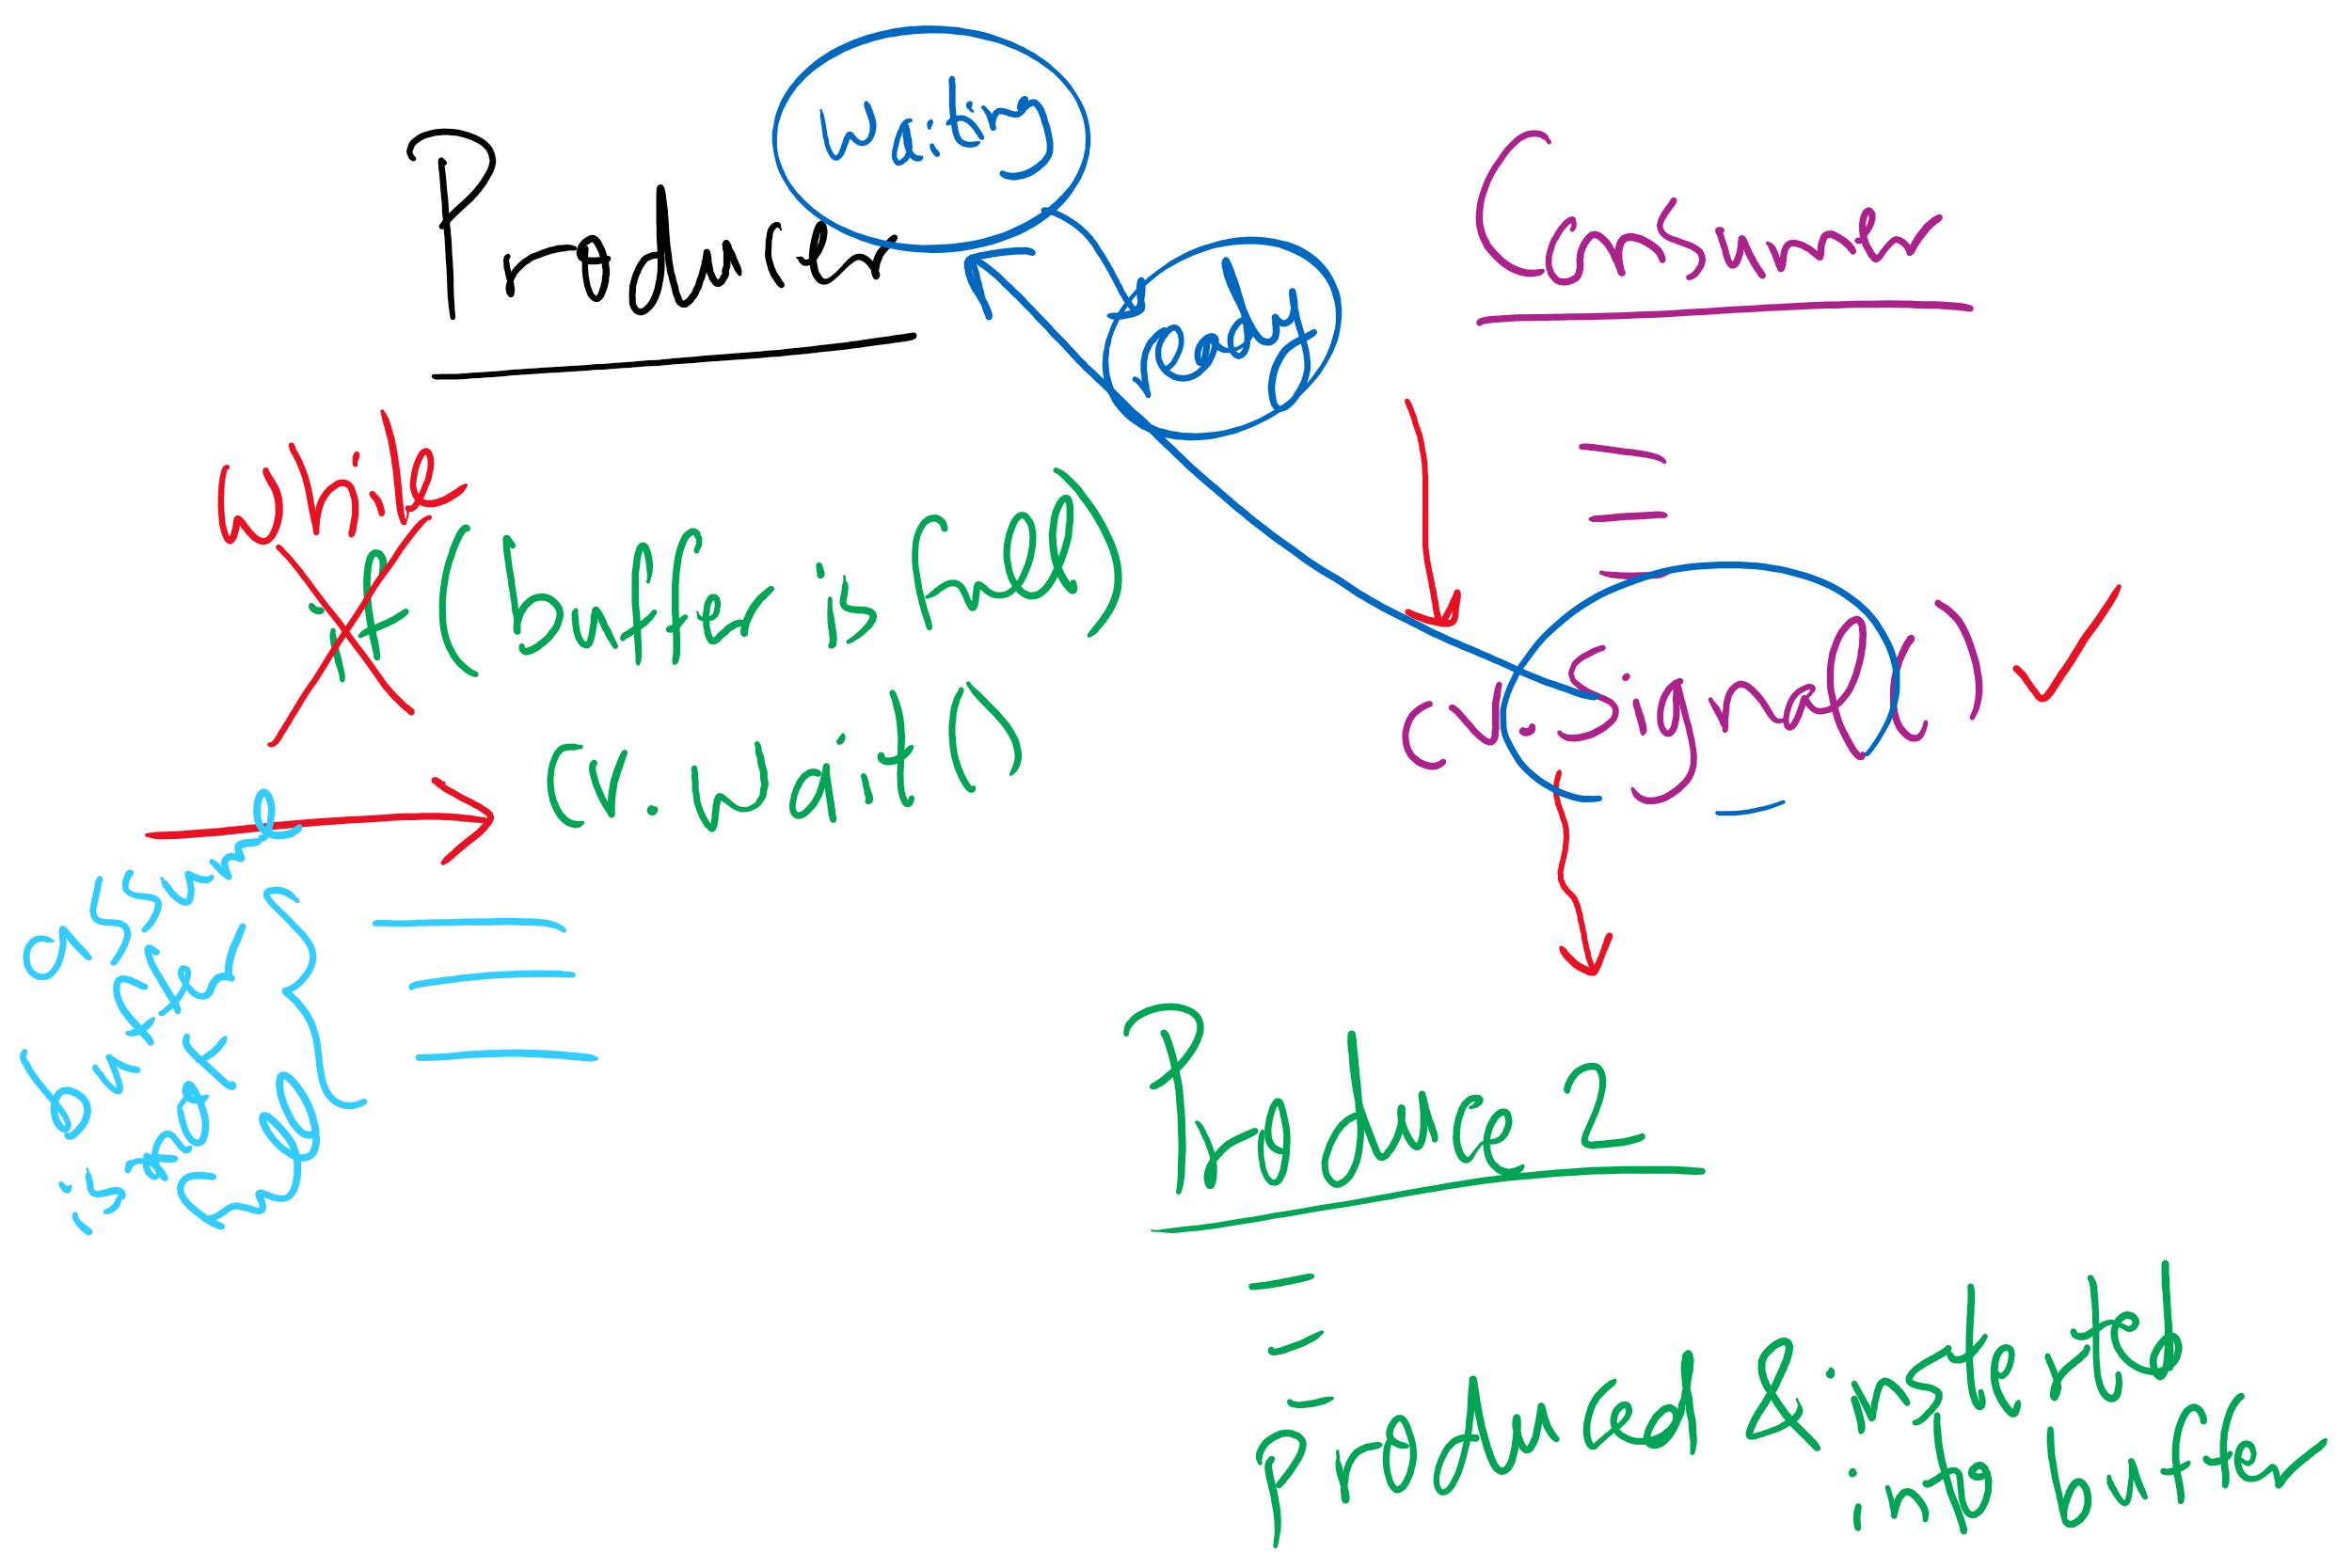
Using while instead of if with wait()

Slide 17
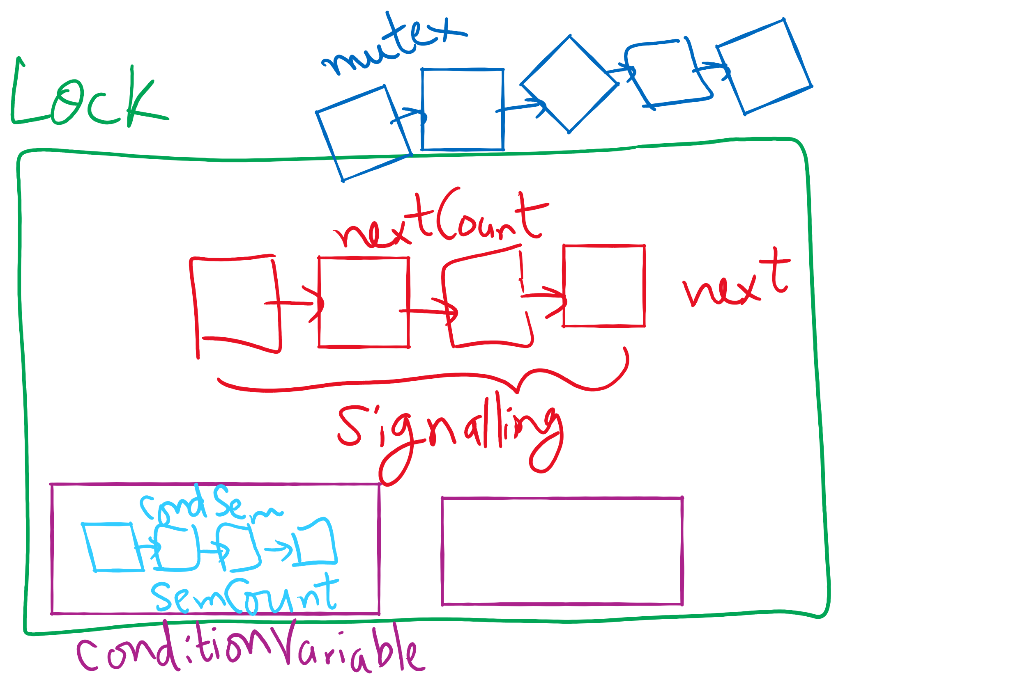
Lock and Condition Variable Implementation

Slide 18
Implementing locks with semaphores
Use mutex to ensure exclusion within the lock bounds
Use next to give lock to processes with a higher priority (why?)
nextCount indicates whether there are any higher priority waiters
class Lock {
Semaphore mutex(1);
Semaphore next(0);
int nextCount = 0;
};
Lock::Acquire()
{
mutex.down();
}
Lock::Release()
{
if (nextCount > 0)
next.up();
else
mutex.up();
}

Slide 19
Implementing condition variables
Are these Hoare or Mesa semantics?
Can there be multiple condition variables for a single Lock?
class Condition {
Lock *lock;
Semaphore condSem(0);
int semCount = 0;
};
Condition::Signal ()
{
if (semCount > 0) {
lock->nextCount += 1;
condSem.up ();
lock->next.down ();
lock->nextCount -= 1;
}
}
Condition::Wait ()
{
semCount += 1;
if (lock->nextCount > 0)
lock->next.up();
else
lock->mutex.up();
condSem.down ();
semCount -= 1;
}

Slide 20
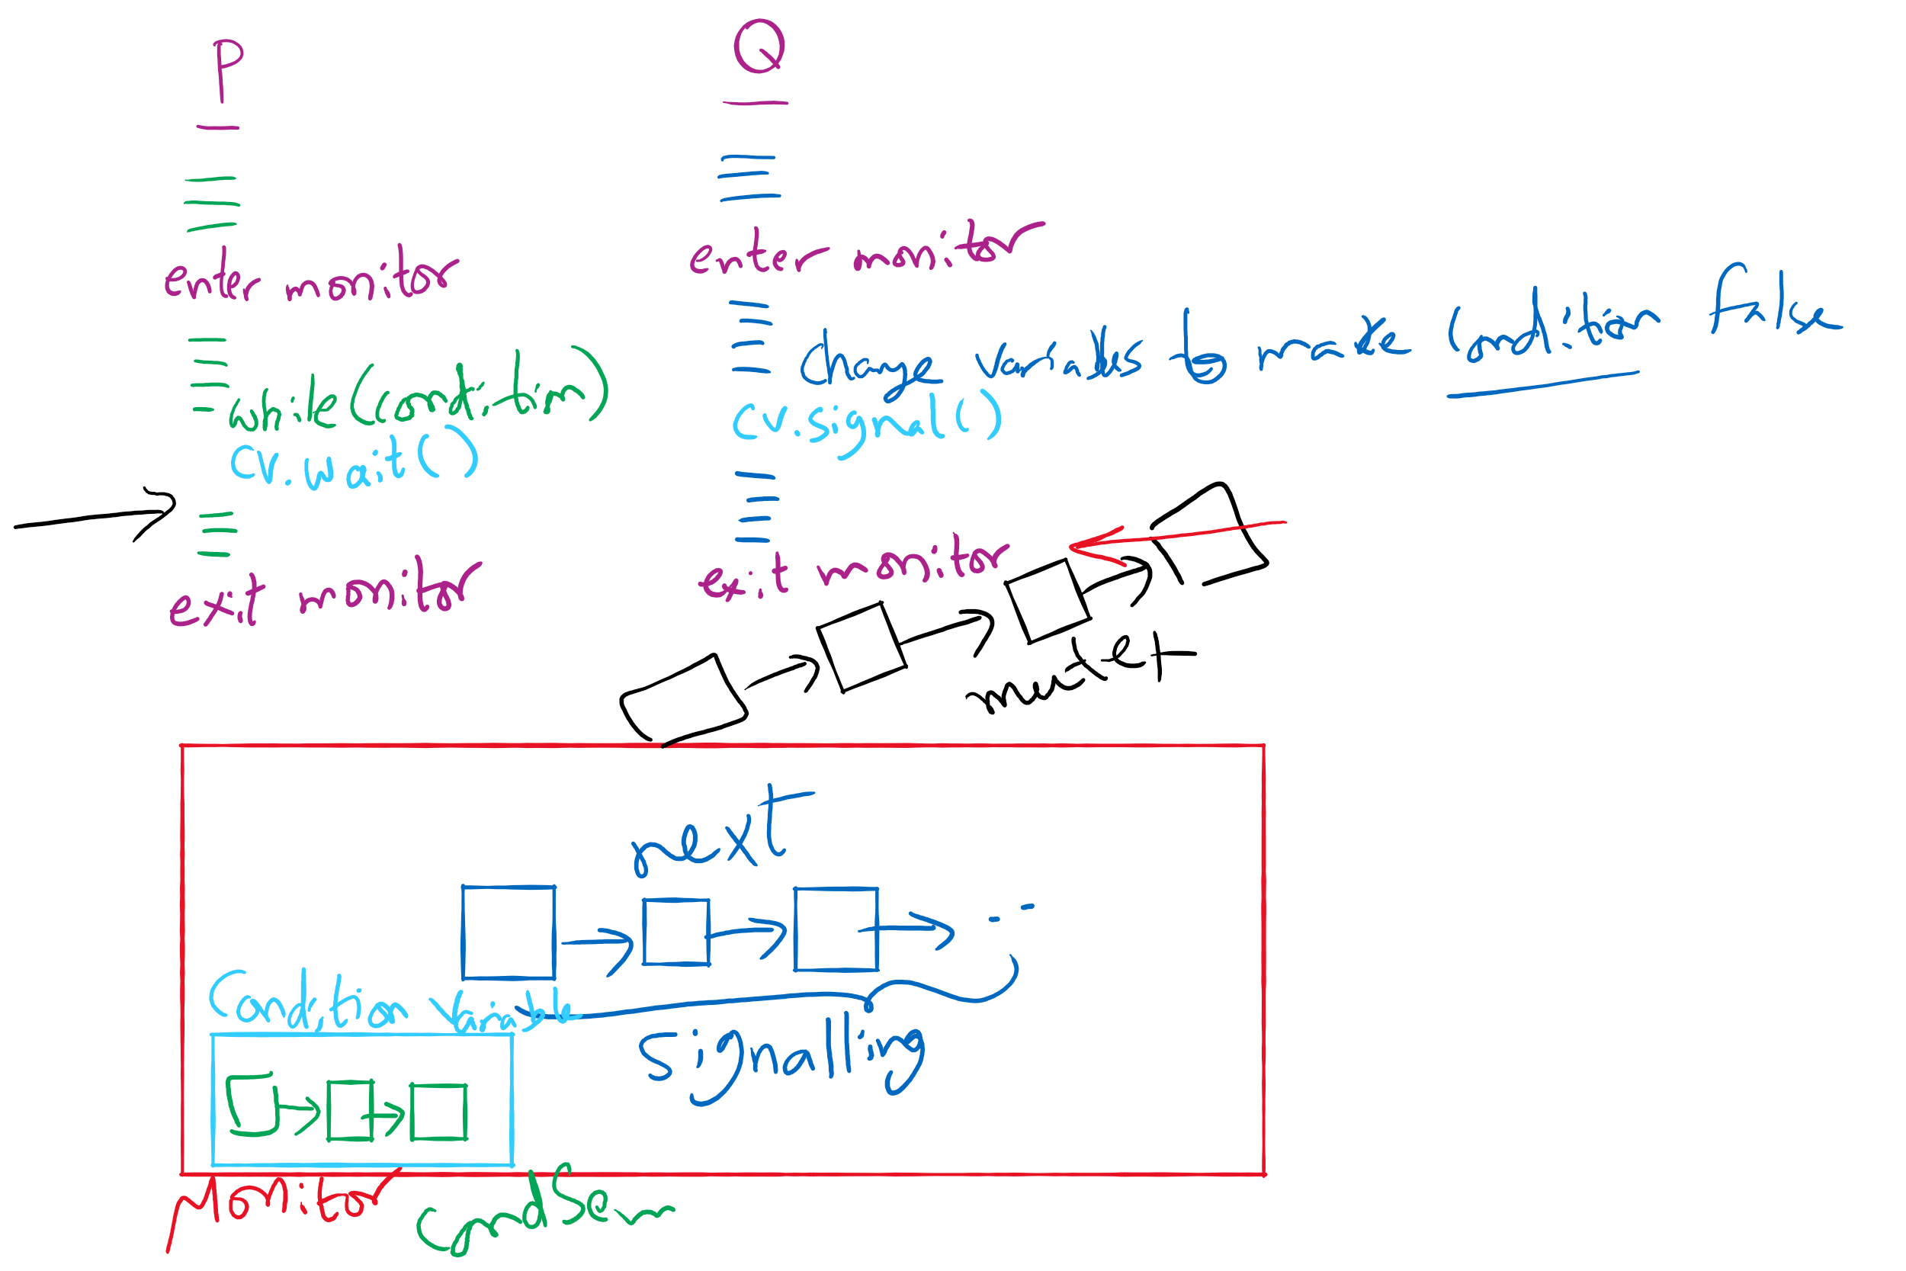
Process Synchronization inside Monitors

Slide 21
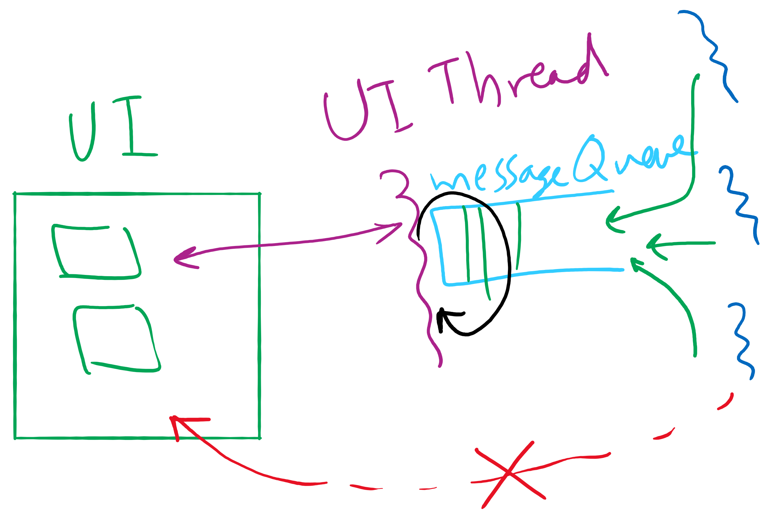
Message passing
Synchronize by exchanging messages
Two primitives:
Send: send a message
Receive: receive a message
Both may specify a “channel” to use
Issue: how does the sender know the receiver got the message?
Issue: authentication

Slide 22
Barriers
Used for synchronizing multiple processes
Processes wait at a “barrier” until all in the group arrive
After all have arrived, all processes can proceed
May be implemented using locks and condition variables
A
A
A
A
B
B
B
B
C
C
C
C
D
D
D
D
Processes approaching
barrier
B and D at
barrier
All at
barrier
Barrier releases all processes

Slide 23
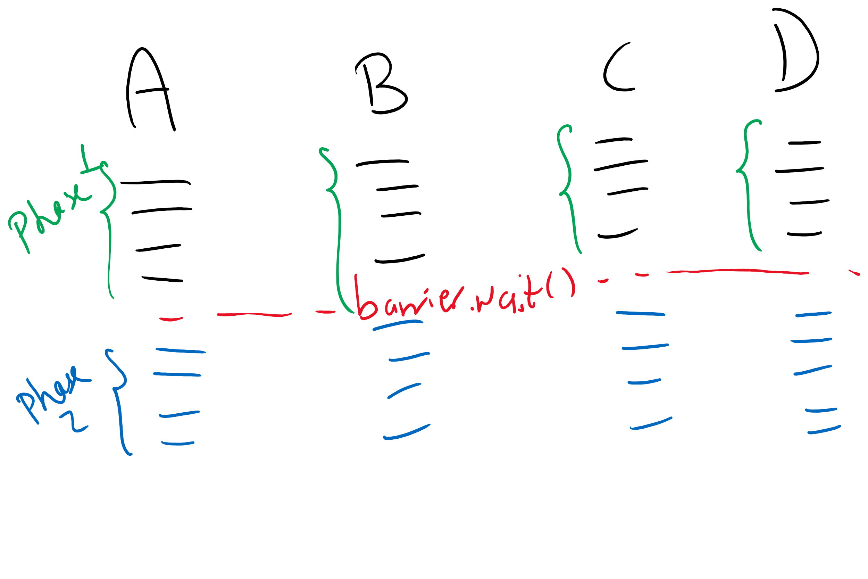
Barriers Example

Slide 24
Examples
Classical Process Synchronization Problems
Bounded Buffer
Readers-Writers
Dining Philosophers

Slide 25
Xv6 Walkthrough
sleep and wakeup

Slide 26
Classical synchronization problems
Bounded Buffer
Multiple producers and consumers
Synchronize access to shared buffer
Readers & Writers
Many processes that may read and/or write
Only one writer allowed at any time
Many readers allowed, but not while a process is writing
Dining Philosophers
Resource allocation problem
N processes and limited resources to perform sequence of tasks
Goal 1: use semaphores to implement solutions to these problems
Goal 2: use locks and condition variables to implement solutions to these problems

Slide 27
Bounded buffer problem
Goal: implement producer-consumer without busy waiting

Slide 28
Thread spawning

